Slide 1
AUTOMATED RATIONSHOP SYSTEM

Slide 2
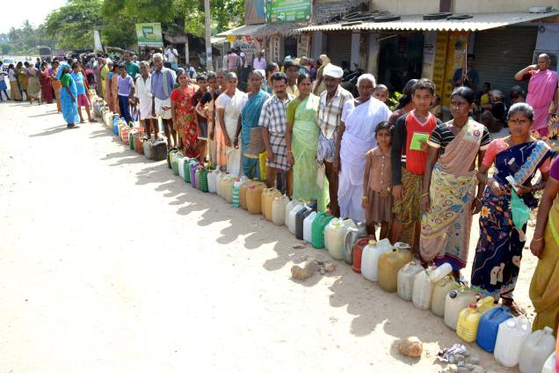
PRESENT RATION SHOP SYSTEM :
Present system is not automated
Is purely based on book entry
If someone else got the card of other family he also can buy items
Employers of the ration shop can do mall practice in stocks maintained
Lack of accountability
Every purchase takes lot of time
Stocks are smuggled outside
Information about availability of items is not known directly to customers
The food grains supplied by the ratio shops are not enough to meet the consumption needs of the poor

Slide 3
NEED OF PROJECT
India is rapidly moving towards evolution of mechanism. Yet ration shops is more vulnerable to misbehaviour.
So to increase the stability and security in the ration shops this project is developed with the help of a Biometric system in an automated environment.
It will ease our purchasing in the ration shops.
By the help of this ‘Automated Ration Shop system’ software we can do all works efficiently and with less time.

Slide 4
OVERVIEW
Automate the present ration shop system and to reduce the flaws in the present system .
Uses RF ID card for each family instead of the ration card and the card type is chosen when registering the card. While registering the card, finger prints of the family members are also registered with the card.
Once the card is registered any member of the particular family can buy the items available for that card .
One purchase per month for particular item .
SMS notification regarding purchase will be sent to the family members.
Stock updating can be done only by the employee of the ration shop.
If stock gets below a particular threshold, a pop up will notify the Employee.

Slide 5
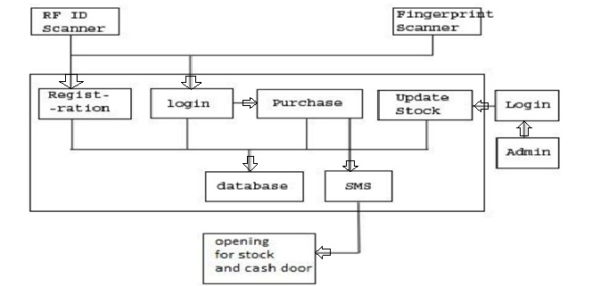
SYSTEM ARCHITECTURE
To implement the system, following architecture is used

Slide 6
WORKING ACTION

Slide 7
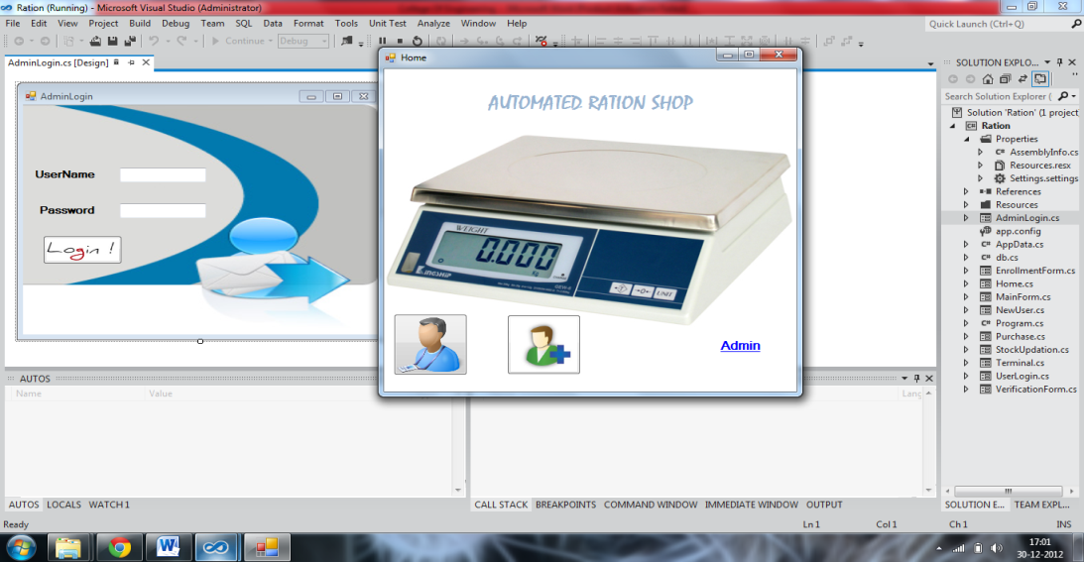
MAIN FORM :
Main window will have various options available like registration, purchase, admin login for the registration purpose.

Slide 8
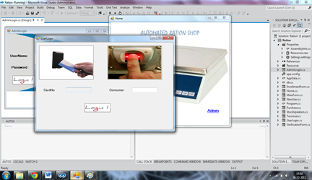
LOGIN FORM :
This form is used for scanning the RF ID card and getting the finger print for the verification of the user.

Slide 9
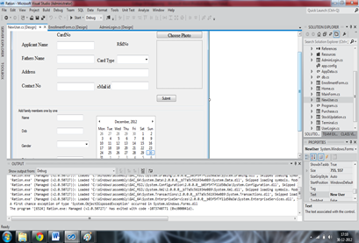
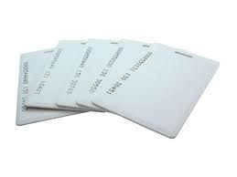
REGISTRATION FORM :
This form used for registration of the new user. In this form, all the details of the family members will be added and the photo of the head of the family will be added.
Each family will be given one RF – ID card this card will act basically like the ration card. Using this RF – ID card, any registered member of the family will be able to purchase items available for that card once in a month.

Slide 10
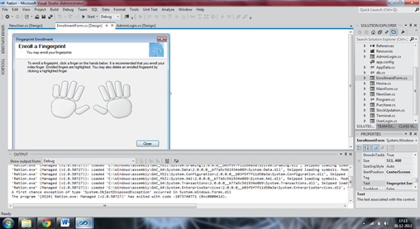

FINGER PRINT ENTRY FORM
Using this form the finger print of the all the family members will be added.
After choosing the finger it will ask for 4 sample of the same finger print if all the finger print matches to 20% then the all the details about the particular person will be added to the data base.

Slide 11
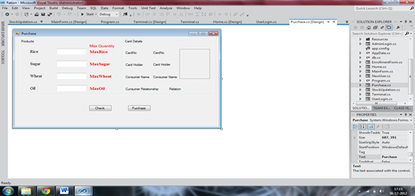
PURCHASE FORM :
In the purchase form the available items for the card will be in the editable with the max quantity available . If it is already purchased all the items will be in the un editable form.
On giving the quantity of the items to be purchased availability of the items in the stock is checked.

Slide 12

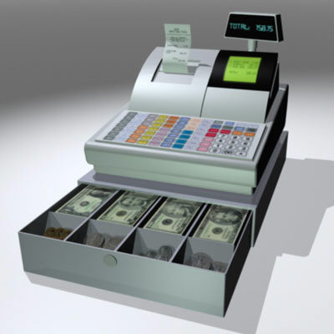
Security and Notification
After the purchase is made SMS containing details of the purchase will be send to the family members.
After the purchase, the cash counter and stock will open.

Slide 13
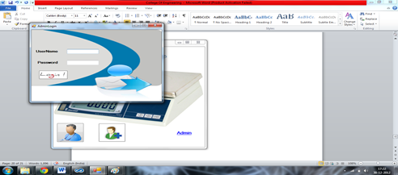

ADMIN LOGIN FORM :
On clicking the admin option in the main window it will prompt for the admin login screen . On giving the username and password of the admin it will lead to the stock updating

Slide 14

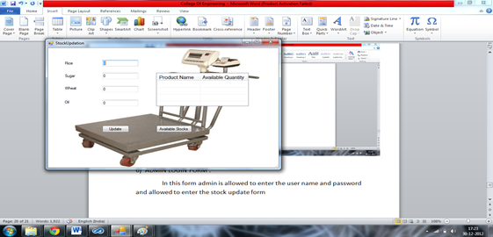
STOCK UPDATE FORM :
In the stock updating form all the available items in the ration shop will be visible. On entering the quantity and clicking add, the particular item ‘s quantity will be added to the stock . It will take place on every stock updating.

Slide 15
HIGHLIGHTS OF PROJECT :
System is purely automated
Employers of the ration shop cannot do mall practice in stocks maintained
Accountability is high
Reduce the purchase time
Stocks cannot be smuggled outside
Information about availability of items is known directly to customers
The food grains will be supplied by the ration shops enough to meet the consumption needs of the poor
Authorized information can be send to the people of particular locality

Slide 16
CONCLUSION
This project is finally designed and tested to automate the present ration shop system , and it will ease our purchase in ration shop and will improve security.

Slide 17
REFERENCES
NAME OF THE BOOK AUTHOR
Visual studio complete reference Noel jecke
Programing in C# Balagurusamy
And also various web sites are referred for some help needed for working in visual studio
URLs:
[Baja Beach Club]Uses implanted RFID tags toidentify and charge VIP members:
http://www.bajabeach.es/
[VeriChip]Company that produces human-implantable RFID chips:
http://www.verichipcorp.com
[EZ-Pass]Electronic toll collection for toll roads and bridges:http://www.e-zpassiag.com
[SpeedPass]Paying at Exxon and Mobile gas stations with RFIDtags:
https://www.speedpass.com/forms/frmHowItWorks.aspx?pPg=howTech.htm&pgHeader=how
[Wiki-RFID]Wikipedia-RFID:http://en.wikipedia.org/wiki/Rfid
R´ıha, Z. (2000).Biometric Authentication Systems. Tech
http://www.ecom-monitor.com/papers/biometricsTR2000.pdf.
Mansfield, T. (2001) Biometric Product Testing – Final Report, National Physical
Laboratory, 2001,http://www.npl.co.uk/.

Slide 18
THANK YOU !!

